Slide 1
GRPC and Micro services

Slide 2
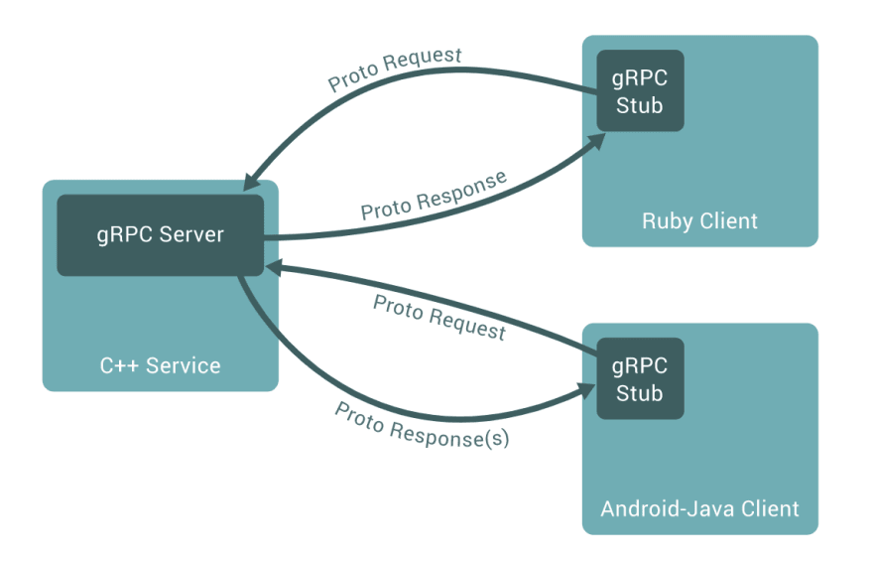
GRPC connection

Slide 3
Benefit
High performance RPC
Run on the cloud
Use Protobuff
Cloud setting handles encryption layer
The traffic from the proxy to the container with gRPC server can go through an encrypted tunnel

Slide 4
Async
StreamObserver<Message> subscribe ( StreamObserver<Message> responseObserver) { return new StreamObserver<Message>()}
PublisherGrpc.PublisherStub(google cloud)
SubscriberGrpc.SubscriberStub(google cloud)

Slide 5
GRPC Steps
Define a service in a .proto file
Generate server and client code using the protocol buffer compiler
Create the server application, implementing the generated service interfaces and spawning the gRPC server
Create the client application, making RPC calls using generated stubs

Slide 6
Example

Slide 7
RPC limitations
It has a limitation on payload size 32MB.

